Slide 1
ESL
English as a Second Language

Slide 2
English Language Learners (ELL) at Coastline
ELL Group 1: Already proficient (fully bilingual)
ELL Group 2: NOT PROFICIENT and NOT TAKING ESL
ELL Group 3: NOT PROFICIENT YET but TAKING ESL
BUILDING SKILLS (reading, writing, speaking, listening)
Preparing for:
Career Education Certificates
A.A. degree programs
Employment

Slide 3
RUBRIC # 2: Demand for Skills
Proficiency in English is REQUIRED for:
ALL certificate programs
ALL AA degree programs
Successful TRANSFER
SUCCESS after college
Workforce requirements
Student goals

Slide 4
ELL students will take YOUR courses (all disciplines) whether they have had ESL or not
Strengthening the ESL Department strengthens every department:
Group 2: Effective outreach to those who are not enrolled in ESL / not ready for your class. The message: Take ESL first!
Group 3: More are well prepared for English demands of your classes

Slide 5
NEW FULL-TIME ESL INSTRUCTOR
Responsibilities beyond the classroom:
Reach out to ELL group #2
(not proficient / not in ESL)
For a program that is large and complex:
Coordinate student placement
3 enhanced noncredit levels (21 sections)
4 credit levels (20 sections)
Plan & implement staff development
Maintain compliance with two Title II grants

Slide 6
Rubric #1:
Implement College Priorities and Initiatives
AB 705 / Guided Pathways
New pathway to ENGLISH 100: Mind the gap!
Must prepare students for accelerated progress & Adjust curriculum: create new prep courses
Strengthen and develop clear pathways to all certificate & AA degree programs
ADAPT TO NEW STATE MANDATES
Continue to build enhanced noncredit program
Implement new assessment / placement practices

Slide 7
ANTICIPATED OUTCOMES
By Hiring a Full-time Instructor
INCREASE ACCESS:
MORE STUDENTS who need ESL will take ESL
INCREASE STUDENT SUCCESS:
New accelerated curriculum will increase success
MORE STUDENTS WILL
Successfully complete ENLISH 100
Compete successfully in certificate & AA degree programs

Slide 8
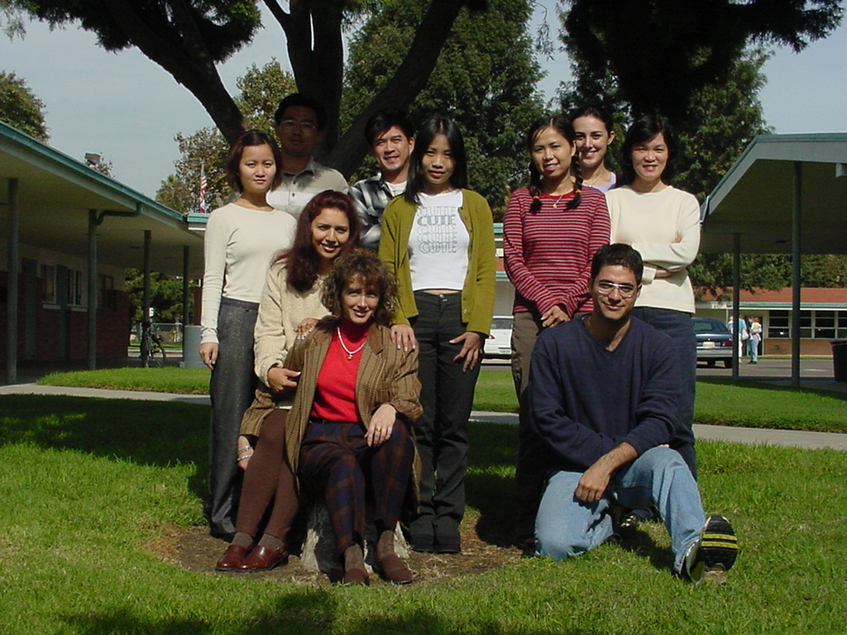
Thank you for considering our request!

Slide 9
Why Bring on a Full-Time Spanish Colleague?
Sandra Basabe
&
Donna Marqués
Creating opportunities for student success

Slide 10
Programmatic Planning
New Course Modality Implementation
More face-to-face courses to support Guided Pathways
Added 1 in Spring 2019, add 1 more for Fall 2019
Result: Increased enrollment, student success, programmatic excellence
Join OEI Course Exchange
Spanish180 enter the course exchange by Spring 2020.
Spanish 185 enter the course exchange by Fall 2020
Result: Increased enrollment, new initiatives, innovation, sustainability

Slide 11
Programmatic Planning
Create Certificate Non-Credit Spanish Classes for Community
Create non-credit program for community members to have basic knowledge of Spanish in:
Medical, law enforcement, hospitality, other needs
Goal: start one certificate program by Fall 2020
Result: Increased enrollment, innovation, partnerships, community, and industry engagement
Create Spanish for Native Speakers Program
Create a 3-course sequence for native speakers of Spanish over 3 semesters, starting Fall 2021.
Offer various modalities for success in Guided Pathways & Spanish Native Speaker Student Outreach.
Result: Increased enrollment, community engagement, planning, innovation, change

Slide 12
Programmatic Planning
Class Sizes Decreased; More Sections Added
Sections went from 80 to 40
Need for more qualified faculty to teach sections
Fall, 2018 forced to cancel sections due to lack of qualified online language applicants
Result: Increased enrollment, student success, programmatic excellence
More Presence on Committees, Panels, Groups, and Councils
Goal: have full-time IL representation on more college committees by Fall 2020. Currently serve on 3.
Result: student success, institutional excellence

Slide 13
Programmatic Planning
Campus Leadership
Participate in campus initiatives such as:
Student Academic Advising
Student Clubs
Spanish Newsletter
Faculty Collaboration & Mentoring
Multi & interdisciplinary Collaboration
Result: student success, programmatic excellence, student retention and persistence, planning, innovation, sustainability

Slide 14
Climate, Job Market, Trends & Mandates
Improve Transfer Rates
General Ed majors need a second language to transfer, supports Guided Pathways
Need to grow our program to meet the needs of transfer students which will lead to the attainment of associate degrees, certificates, career readiness, and transfer to four-year colleges/universities
Result: Increased enrollment, student achievement, programmatic excellence, student persistence, planning, innovation, change, sustainability

Slide 15
Climate, Job Market, Trends & Mandates
Employability
“Bilingual Applicants Preferred”
44% of Californians speak Spanish
Result: Increased enrollment, programmatic excellence, student persistence, planning, innovation, change, partnerships & community engagement

Slide 16
¡Gracias! Sandra Basabe Donna Marqués
Help us to realize our vision by
bringing on another full-time Spanish colleague!

Slide 17
Tobi West CST Full Time Faculty

Slide 18
Program Planning & Initiatives
CST Program Growth
Cyber Up! DFIR
Palo Alto Regional Academy
04
NSF grant for development of Digital Forensics & Incident Response degree
03
Develop courses and run a regional academy
02
01
8 program courses, career-readiness workshops, industry relationships
Develop a degree and courses with Business Department
Cybersecurity Apprenticeship Program
Data Analytics

Slide 20
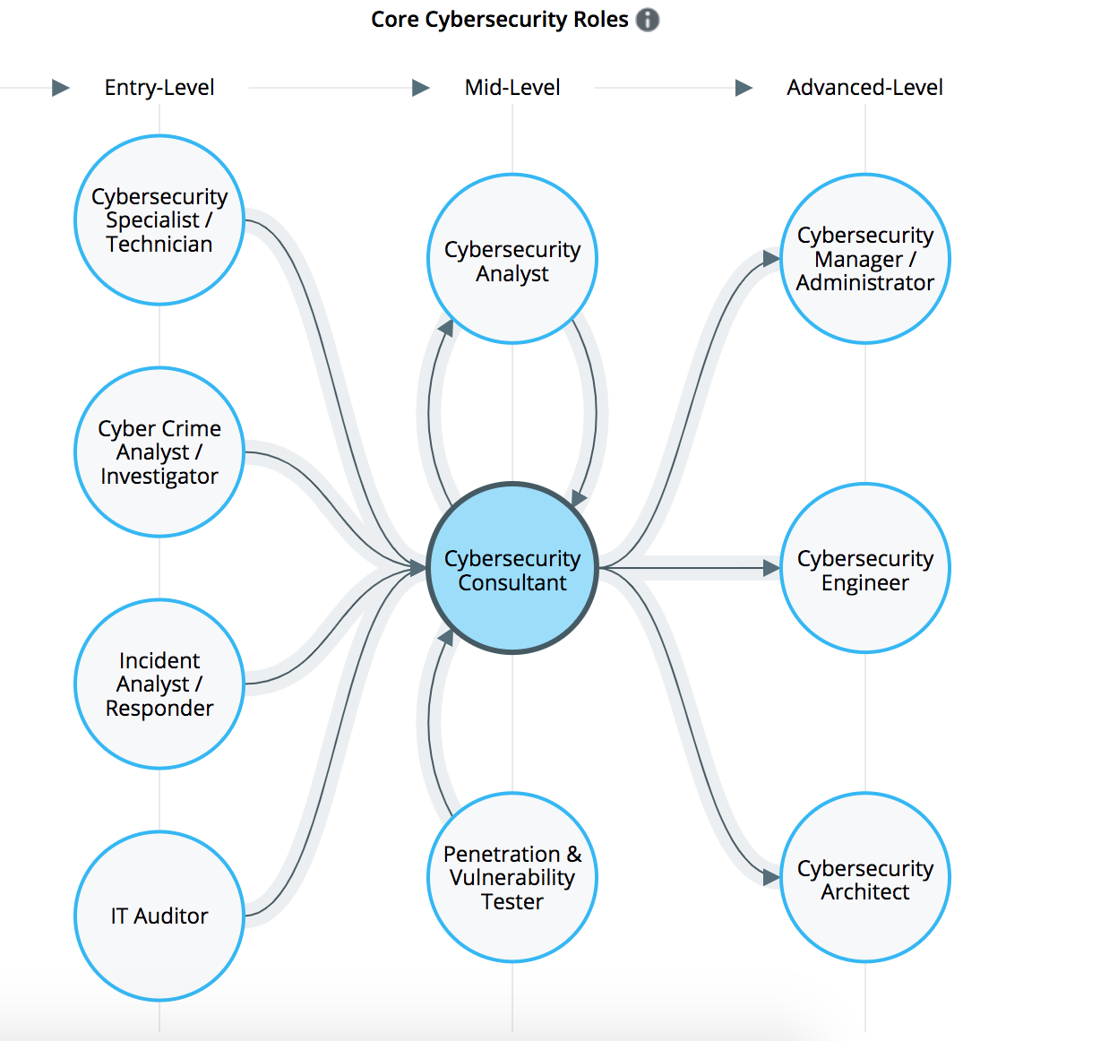

Slide 21
3.5M
openings

Slide 22
Growth Across Industries

Slide 23
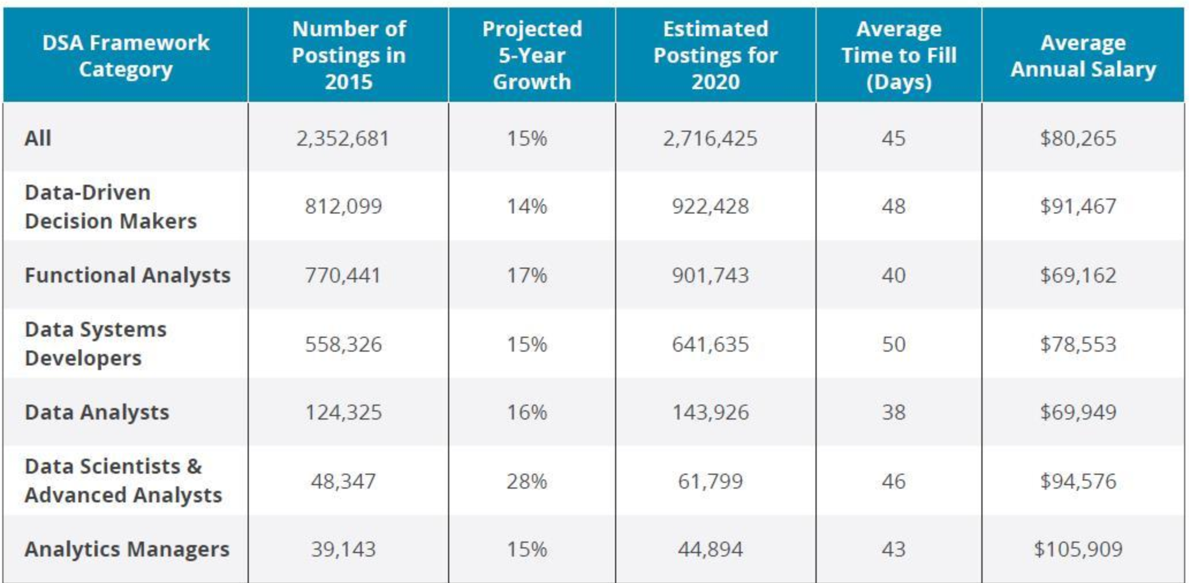
Data Analytics & Business Intelligence Professionals
By 2020, the number of jobs for all US data professionals will increase by 364,000 openings to 2,716,425 according to IBM.

Slide 24
Pathways to Success
K-12 to Coastline to University
Pathway Days
4 YR
Concurrent Enrollment
CCC
Cyber
Tech Girls
Cyber
Patriot

Slide 25
New Faculty
Program Growth
National Recognition
Program Growth
Student Engagement
More time with CST Faculty
Largest Growth in Job Openings
Better Prepared for Industry Roles in Cybersecurity & Data Analytics
Career Readiness
Prepared for their new roles

Slide 26
Accounting Faculty Prioritization
Fall 2019: Full-Time Accounting Faculty Supporting Data

Slide 27
Accounting Faculty Prioritization
1. Program Planning: Proposed Score 6
Human Capital Planning – Per Program Review
Due to the projected job growth in Accounting related fields, the Business Department feels that the addition of a Full-Time Accounting Faculty is needed to maintain and grow current FTEs and Fill Rates. The primary focus of the new faculty member will be to provide entry level job skills training as well as transition programs leading to advanced training.
Year | Administrator | Management | F/T Faculty | P/T Faculty | Classified | Hourly
Previous year 2018-19 | Position Title (# of positions) | 0 | 5 | 28 | 0 | 0
Current year 2019-20 | Position Title (# of positions) | 0 | 6 | 25 | 0 | 0

Slide 28
Educational Climate for Career & Technical Education
Shift to Non-Credit Courses
Stackable Certificates
Online Courses vs. Onsite
Social Awareness – VITA
Guided Pathways
Embedded/Regular Tutors
K-12 to Four Year
Partnerships – Centers
Transfer
Success
Career
Military / Veterans Resource
ESL

Slide 29
Accounting Faculty Prioritization

Slide 30
Accounting Faculty Prioritization Proposed Score 6
2. Job Market and Industry Demand
Orange County’s high quality of life, diverse economy, and well-educated workforce has propelled the county to lead the region in growth and prosperity, allowing it to recover from the Great Recession quicker than neighboring counties and peer regions across the nation. However, a growing and persistent skills gap threatens continued success. Even as unemployment rates are at record lows, employers face rising difficulties in filling positions with skilled, educated workers.
Orange County’s marketplace combined with its robust and diverse economy make Orange County a desirable place for employers to do business:
From 2016 to 7-2017 the county added 180,000 residents, which brought the total population to an estimated 3,190,265, a 6 percent increase since 2010.
Median household income of Orange County residents is roughly $78,145, nearly $15,000 greater than the California state median income and more than $20,000 higher than the United States’ median.
Orange County’s economic strength is reflected in its low unemployment rate which consistently runs lower than that of the statewide average. According to the California Employment Development Department Orange County’s unemployment rate was at 3.1%; below the state average of 4.3% (2018). Additionally, Orange County created 11,000 jobs in the last year.

Slide 31
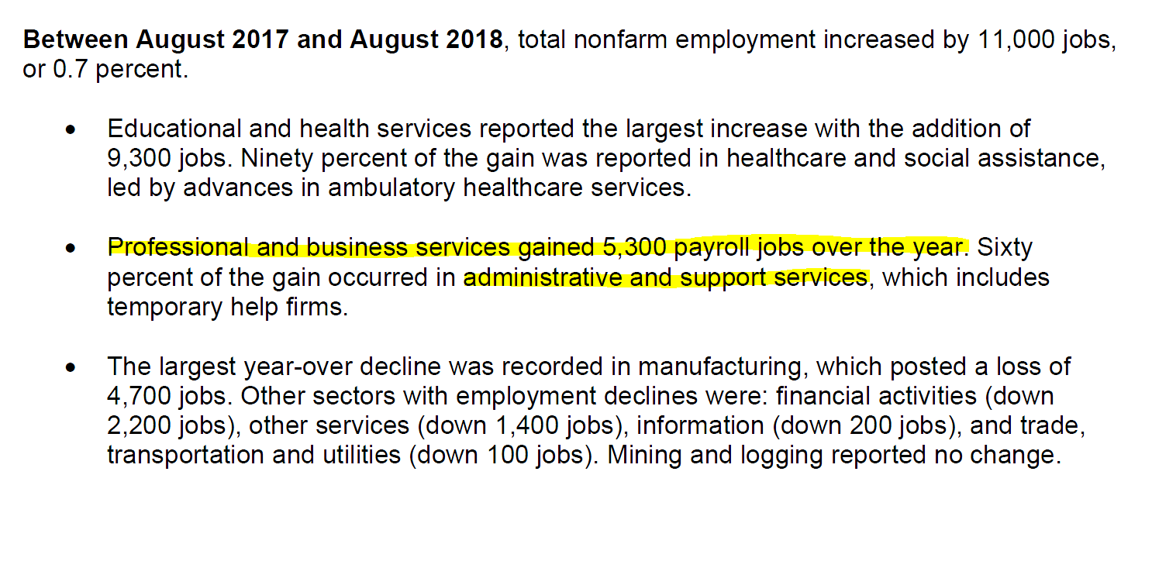
Accounting Faculty Prioritization Proposed Score 6

Slide 32
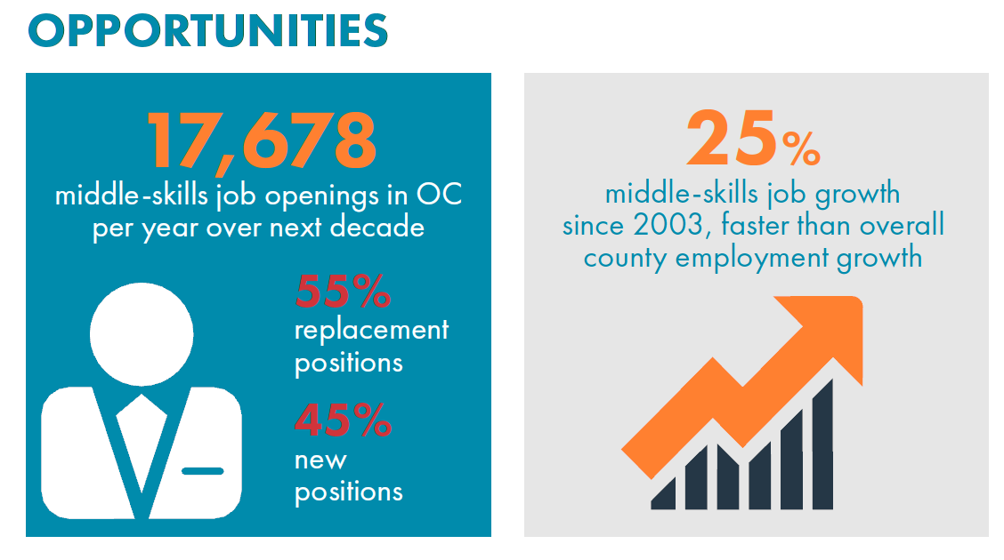
Accounting Faculty Prioritization Proposed Score 6

Slide 33
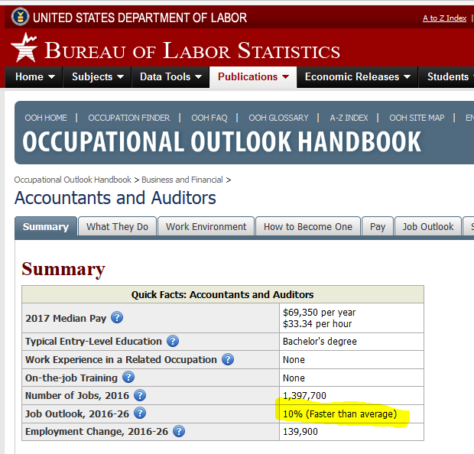
Accounting Faculty Prioritization Proposed Score 6

Slide 34
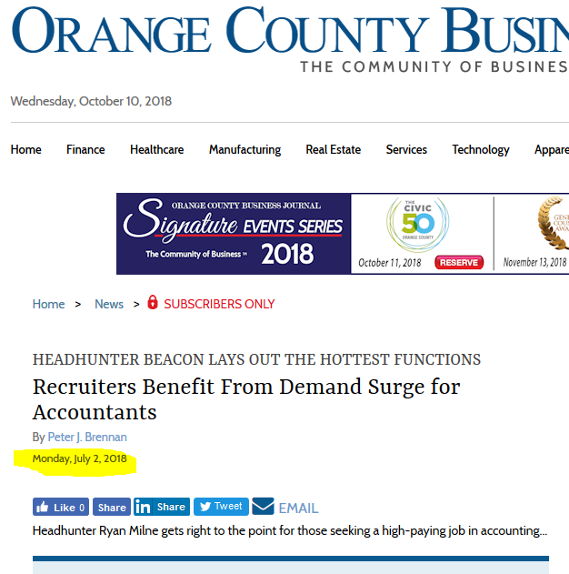
Accounting Faculty Prioritization

Slide 35
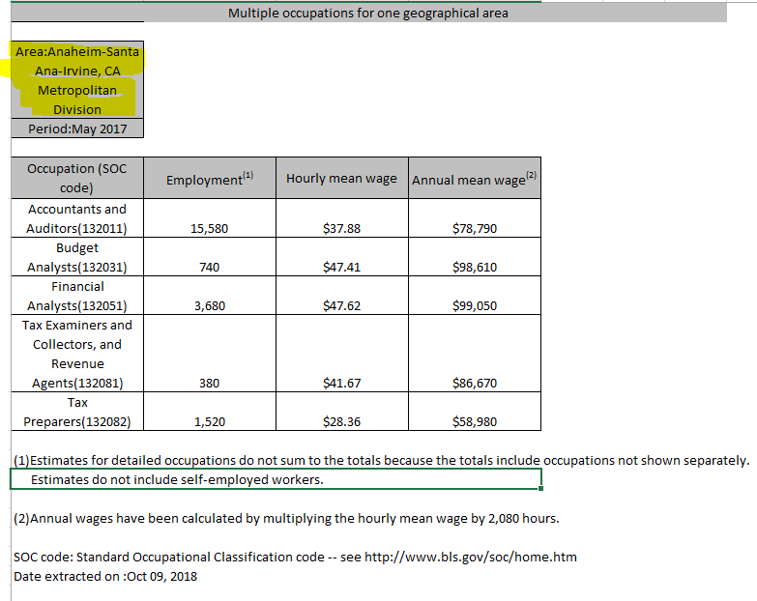
2. Job Market and Industry Demand

Slide 36
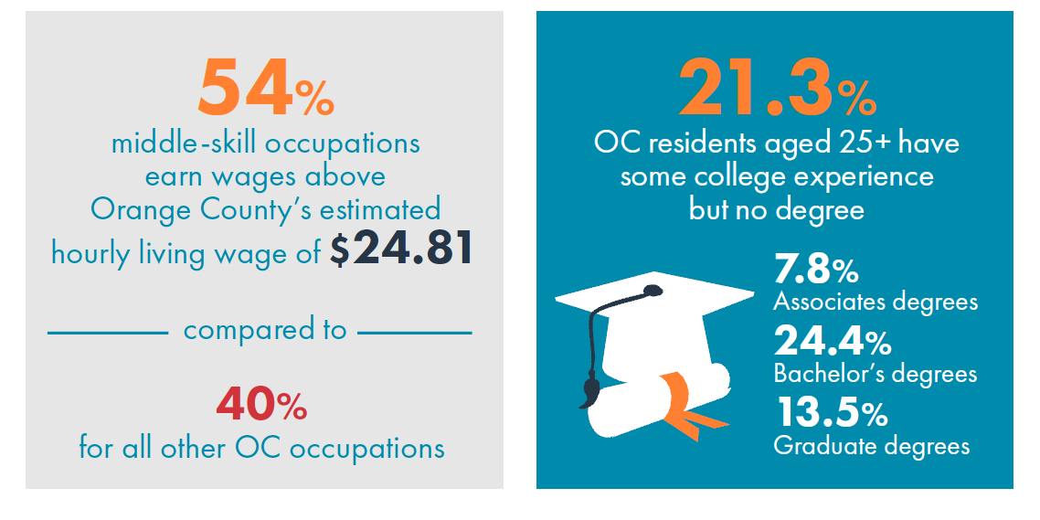
Accounting Faculty Prioritization Proposed Score 6

Slide 38
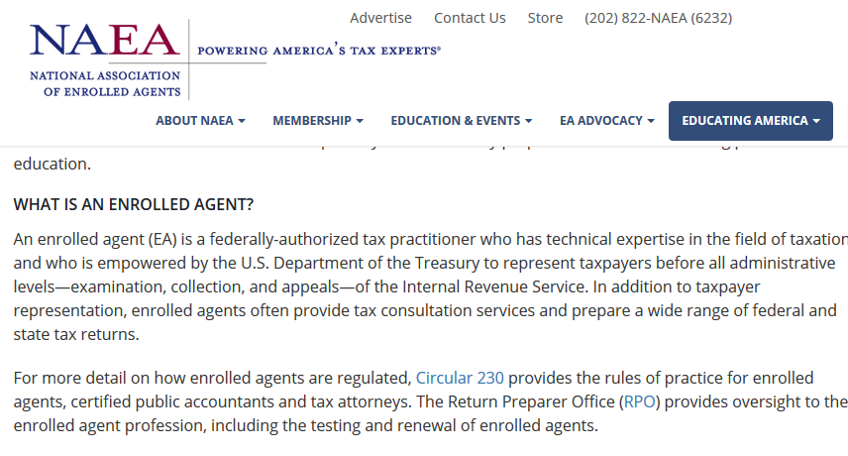
Middle Skills Jobs in Accounting & Tax

Slide 39
Accounting Faculty Prioritization
College Major Trends
The Overall Success Rate and Overall Retention Rate for Accounting students has remained stable averaging 61.7% (Success Rate) and 77.0% (Retention Rate) over the past three years.
Based on modality, Traditional classes consistently result in higher Success/Retention Rates. Traditional classes experience an 83.1% Success Rate and 89.8% Retention Rate compared to and Online classes (60.0% and 74.00%, respectively). This clearly indicates that students that have the structure and support (instructor and tutoring services) do better in Accounting courses.
Age demographics indicate that the majority of our Accounting students are older (30-39 years) and taking courses in addition to work and family responsibilities.

Slide 40
Accounting Faculty Prioritization Proposed Score 6
Additional Information:
Priorities and Plan:
Specific Goals 2019-20-Year:
Expanded Pathways with CSUs, UCs; and private Colleges.
Expand activities that are typically only at the four year universities.
Volunteer Income Tax Assistance VITA – 2018 Goal serve 300 taxpayers
Meet the Firms – Students meet face to face with Local and Regional CPA Firms for jobs and mentorships.
Create Tax Programs that qualify students to certify for immediate employment (H&R Block, CTEC, EA)
Develop Data Analytics Courses & Program to keep accounting department relevant
The scope and effectiveness of these programs will be greatly enhanced with the addition of full-time staff to champion activities.

Slide 41
In 6 Minutes:
Why Coastline needs a Full Time
LIBRARIAN
Notes:
Hi it’s Elizabeth from the Library and In 6 minutes I will tell you Why Coastline need a full time Librarian.

Slide 42
State Funded
Library
Services
Platform (LSP)
Subjective Criteria #2
Notes:
Let’s jump straight to “Subjective Criteria #2”.
The State of California is funding a Library Services Platform that at least 75 of the 114 community colleges are going to implement. Coastline and our sister colleges are migrating to this system and the migration starts in January 2019.
The Library Services Platform will increase access to Coastline Library ELECTRONIC Resources and allow students to search for physical books and open resources across the state. The Cal-State Libraries use the system the community colleges are adopting and the UCs are looking at the same system. It has the potential to support students and increase access in ways we have never seen before!
This project AND ongoing management of this system is a full time job. The librarian overseeing this kind of project is a “Systems Librarian” who has expertise in back-end library information systems and cataloging. I do not have those skills. The Systems Librarian links the Coastline Library resources to the system and continuously work within the system to make sure student can access resources seamlessly.
Every community college in the state except Coastline and Oxnard, who both have SOLO librarians, have a “Systems Librarian”. In order to serve our student effectively with this state funded project, it is imperative that Coastline hire another full time librarian.

Slide 43
Library Services
OMG!
Subjective Criteria #1
Notes:
OMG! Library Services are exploding!
Let’s go to Subjective Criteria #1!
In my two years at Coastline I have tired to increase awareness of Library Resources and services and this year our statistics show my hard work might of paid of too much.

Slide 44
Library Reference
Fall 2016 - 256 Reference Questions Answered
Fall 2017 - 236 Reference Questions Answered
Fall 2018: 1st 7 weeks
307 Reference Questions Answered
OMG!
Subjective Criteria #1
Notes:
Library Reference
Fall 2016 - 256
Fall 2017 - 236
Fall 2018 - 307 in first 7 weeks!

Slide 45
Library F2F Outreach & Instruction
Fall 2016 - 152 People in Sessions
Fall 2017 - 176 People in Sessions
Fall 2018: 1st 7 weeks
428 People in Sessions
OMG!
Subjective Criteria #1
Notes:
Library F@F Outreach & Instruction
Fall 2016 - 152
Fall 2017 - 176
Fall 2018 - 428 in first 7 weeks!

Slide 46
Avoiding Plagiarism Library Workshop
PILOT Spring 2018 - 232
Summer 2018 - 196
Fall 2018: 1st 7 weeks
256 as of 10.10.2018
OMG!
Subjective Criteria #1
Notes:
AP
Spring 2018 - 232
Summer - 196
Fall 2018 - 256 in first 7 weeks!

Slide 47
THANK YOU!
OMG!
Subjective Criteria #1
Notes:
So first, Thank YOU so much for directing students to the Library and helping to spread awareness of our resources.
This is awesome and the LIbrary looks forward to expanding our services and especially designing learning opportunities for incarcerated students.

Slide 48
Coastline Community College steadfastly focuses on providing access and supporting student success and achievement. Inspired by an innovative and student-centered mindset, Coastline delivers flexible courses and services that cultivate and guide diverse student populations across the globe to complete pathways leading to the attainment of associate degrees, certificates, career readiness, and transfer to four-year colleges/universities.
2016-2020 College Goals:
Access and student support
Student Success, Completion, and Achievement
Guided Pathways: Student Life Cycle
Persist
Succeed
Notes:
To continue to support the mission of Coastline College and to provide Access and Student support as well as help student complete the college goal of success, completion and achievement; I am asking for a Full Time Librarian to manage and the state funded Library Services Platform as well as expand Library instruction and Reference services and especially to create equitable opportunities for all our students to have access to library resources and to have supplemental instruction when needed.
The Coastline Library serves ALL Coastline students and employees. My top priority is customer service and pretty soon I am going to be stretched too thin to be effective at this if I am the only full time librarian . I will come to this meeting every year asking for a full time librarian because our students deserve it.
Thank you for your time and your VOTE!

Slide 49
Health Sciences
Food & Nutrition, Gerontology, Health, Kinesiology, and Physical Education
Presented By: Laurie Runk, PhD, CSCS

Slide 50
Food & Nutrition
Certified Dietary Manager Program

Slide 51
INITIATIVE 1:
The CDM-CFPP is the ONLY credential listed in addition to the RDN that is qualified to participate Interdisciplinary Team (IDT) as defined by Scopes of Practice.
Build Certified Dietary Manager Program to meet the current and future market needs as a result of new regulations.

Slide 52
Immediate Workforce Need
“All individuals who are currently employed as the designated Director of Food and Nutrition Services will have until 2021 to complete the CDM-CFPP credential” – CMS
2016
Centers for Medicare & Medicaid Services change regulations for Food and Nutrition Services
2017
CDM certificate primary qualification for new hires of Director of Food and Nutrition Services
2021
CDM-CFPP Mandatory Job Requirement for Director of Food Service and Nutrition

Slide 53
Why Coastline?
Only 4 Programs in the State of California…
NONE ARE ONLINE!
Program Director is a licensed dietitian
Full-time faculty member with:
at least two years of practitioner competency
teaching responsibility at the program site

Slide 54
GERONTOLOGY HUMAN SERVICES SOCIOLOGY
Gerontology
Sociology
Human Services
Public Health ADT & Community Health Certificate

Slide 55
INITIATIVE 2:
Create an Interdisciplinary Pathway with Public Health ADT and a Community Health Worker Certificate

Slide 56
Why Combine These Areas?
Public Health Students are coming to COASTLINE for required classes in:
Practical alternative to NURSING
Compliments current Human Services & Wellness Coaching Pathways
New Pathway in Addiction Studies
Employer Groups are requesting Interdisciplinary Coursework
Gerontology
Sociology
Health
Human Services
I’m
Transferring to…
JOB
OPTIONS!!
Sex & Gender
Race & Ethnicity
Diversity
Wellness Coaching
Case Management

Slide 57
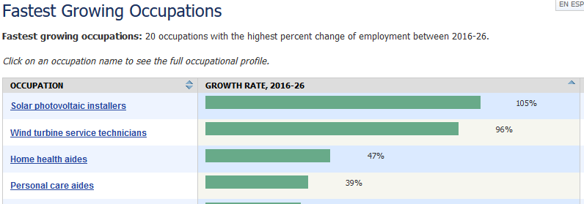
Is there a need?
LOCALLY
The California Department of Public Health (CDPH) set initiative to make California the healthiest state in the country by 2022.
NATIONALY
According to BLS data, Community Health Workers make up the
3RD and 4TH fastest growing occupations!

Slide 58
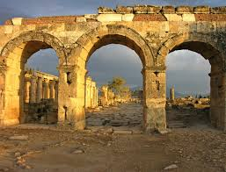
SOCIAL SCIENCES DEPARTMENT
Faculty Prioritization Presentation –
History
Presented by:
Laura Enomoto, Department Chair
Dan Johnson, Professor
The Gateway to Learning

Slide 59
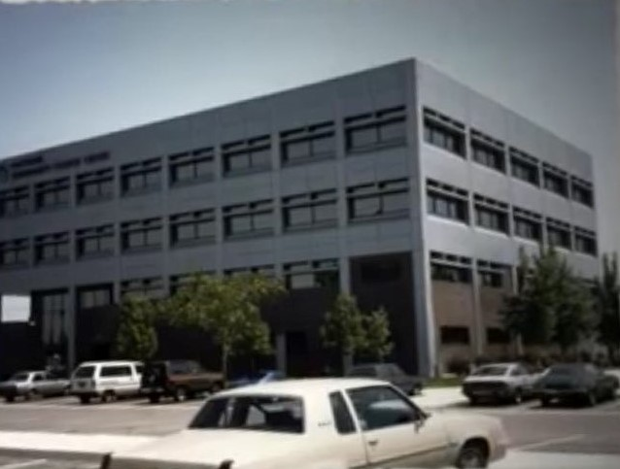
Meets Coastline’s Core Degree Level Outcomes
History is a Gateway to other disciplines
Understand and act upon their ethical civic, environmental, and social responsibilities
Apply critical thinking and analysis skills
Develop an understanding and respect for cultural and global diversity
Competently evaluate information
Use effective communication and interpersonal skills
History teaches critical skills necessary for success in college and the workplace
circa 1976

Slide 60
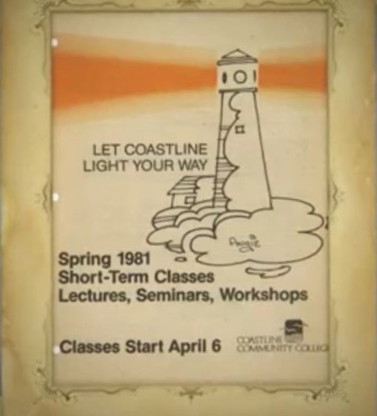
History courses required for Coastline degrees
8 history courses count toward “Global and Multicultural Studies” requirement for ALL Associates Degrees
All history courses count toward General Education, Social and Behavioral Sciences, and Humanities requirements for ALL Associates Degrees
U.S. History courses required for CSU American Institution requirement
circa 1981

Slide 61
History leads to degrees
In addition to offering an AA and AD-T in History, this discipline is an important component in a number of other degrees offered by Coastline, including American Studies, Arts and Humanities, and Social and Behavioral Science

Slide 62
History prepares students for careers
History students gain analytical, writing, and oral skills
History students are prepared for numerous careers
History students have an advantage in applying to professional schools
“The major prepares students with analytical, writing and oral skills that are useful not only for further study in history and the humanities, but also for numerous professional careers. The study of History can also provide students with an important advantage in applying to professional schools: for instance, students with BAs in History and the Humanities who have also taken the necessary basic science courses have a better statistical chance of admission to Medical School than do students who majored in science.” http://www.history.ucsb.edu/academics/undergraduate/careers-for-history-majors/

Slide 63
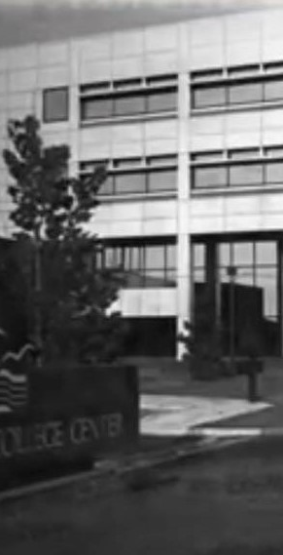
Need to diversify course offerings
Recently expanded offerings to include Chicano History and Latin American History
Need to continue to diversify course offerings to spur student interest and offer greater Global and Multicultural perspectives
Need full-time faculty member with different area of specialty than current full-time professor

Slide 64
Aligns with master plan initiatives
Increase student success, retention, and persistence across all instructional delivery modalities with emphasis in distance education
Full-time faculty would bring stability and be more available to students than part-time faculty are able = increase in retention/persistence
Strengthen post-Coastline outcomes (e.g., transfer, job placement)
Full-time faculty can mentor students and guide them toward academic opportunities in history and related fields
Strengthen community engagement (e.g., student life, alumni relations, industry and academic alliances)
Full-time faculty can form a history club, bring in guest speakers, coordinate field trips, & serve as a liaison with local museums and other public history agencies

Slide 65
Summary
Full-time history faculty
Diversify Course Offerings
Strengthen & Stabilize Department
Expand number of sections offered
Increase student success, retention, and persistence

Slide 66
WHY COASTLINE AND THE WORLD NEED BIOLOGY MAJORS
FACULTY PRIORITIZATION
BIOLOGY (LIFE SCIENCES)
Tomorrow’s College Today.

Slide 67
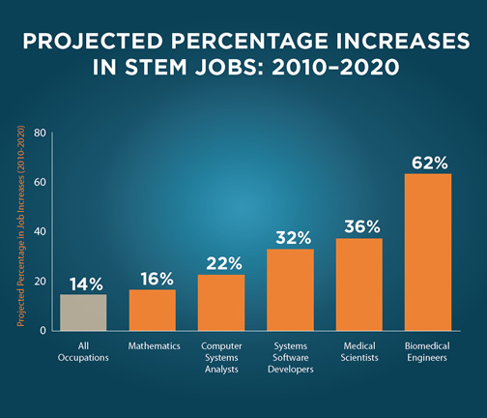
"[Science] is more than a school subject, or the periodic table, or the properties of waves. It is an approach to the world, a critical way to understand and explore and engage with the world, and then have the capacity to change that world..."
President Barack Obama, March 23, 2015
Tomorrow’s College Today.

Slide 68
Table 1.4 Occupations with the most job growth, 2016 and projected 2026 (Numbers in thousands)
2016 National Employment Matrix title and code |  | Employment |  | Change, 2016-26 |  | Median annual wage, 2017⁽¹⁾
 |  | 2016 | 2026 | Number | Percent
Total, all occupations | 00-0000 | 156,063.8 | 167,582.3 | 11,518.6 | 7.4 | $37,690
Personal care aides | 39-9021 | 2,016.1 | 2,793.8 | 777.6 | 38.6 | $23,100
Combined food preparation and serving workers, including fast food | 35-3021 | 3,452.2 | 4,032.1 | 579.9 | 16.8 | $20,180
Registered nurses | 29-1141 | 2,955.2 | 3,393.2 | 438.1 | 14.8 | $70,000
Home health aides | 31-1011 | 911.5 | 1,342.7 | 431.2 | 47.3 | $23,210
Software developers, applications | 15-1132 | 831.3 | 1,086.6 | 255.4 | 30.7 | $101,790
Janitors and cleaners, except maids and housekeeping cleaners | 37-2011 | 2,384.6 | 2,621.2 | 236.5 | 9.9 | $24,990
General and operations managers | 11-1021 | 2,263.1 | 2,468.3 | 205.2 | 9.1 | $100,410
Laborers and freight, stock, and material movers, hand | 53-7062 | 2,628.4 | 2,828.1 | 199.7 | 7.6 | $27,040
Medical assistants | 31-9092 | 634.4 | 818.4 | 183.9 | 29.0 | $32,480
Waiters and waitresses | 35-3031 | 2,600.5 | 2,783.0 | 182.5 | 7.0 | $20,820
Nursing assistants | 31-1014 | 1,510.3 | 1,683.7 | 173.4 | 11.5 | $27,520
Tomorrow’s College Today.

Slide 69
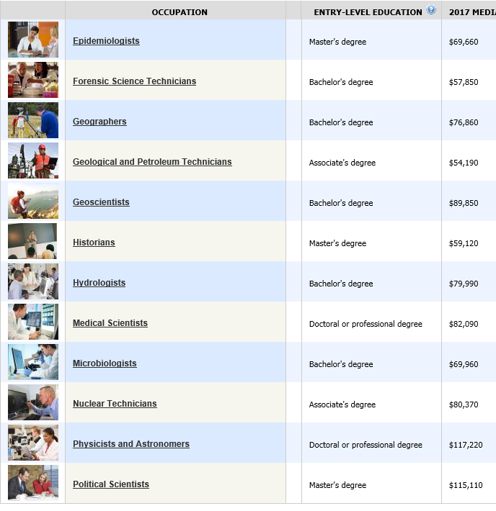
Tomorrow’s College Today.

Slide 70
Program Review Initiatives-Past Program Reviews
Hire 2nd Full Time Instructional Lab Associate
Develop a STEAM academy
Open a Human Cadaver Lab
Host a Health Science Triathlon
Create New Lab Space at Garden Grove
Market the Health Science Certificate/Biology ADT
Create a new Biotechnology Certificate
3D Printing-Prosthetics
Tomorrow’s College Today.

Slide 71
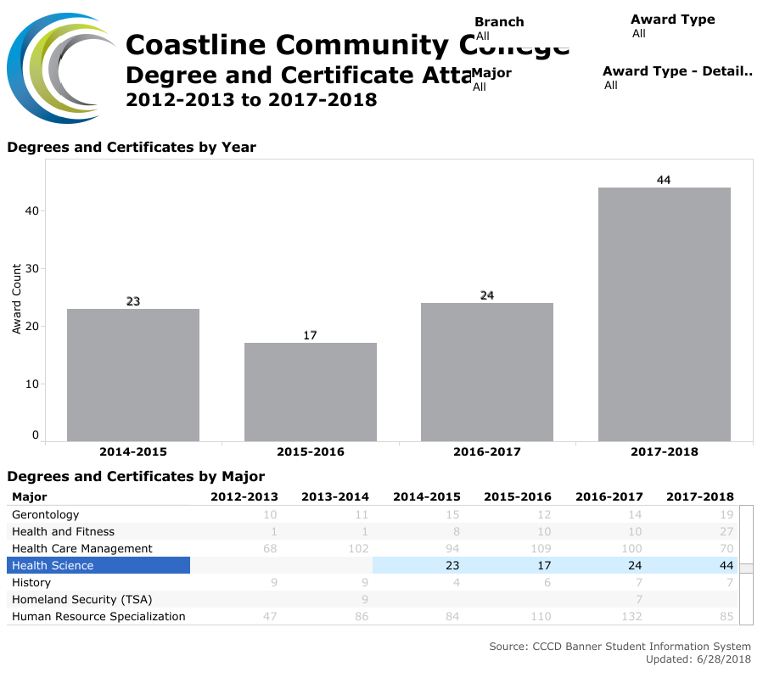
Tomorrow’s College Today.

Slide 72
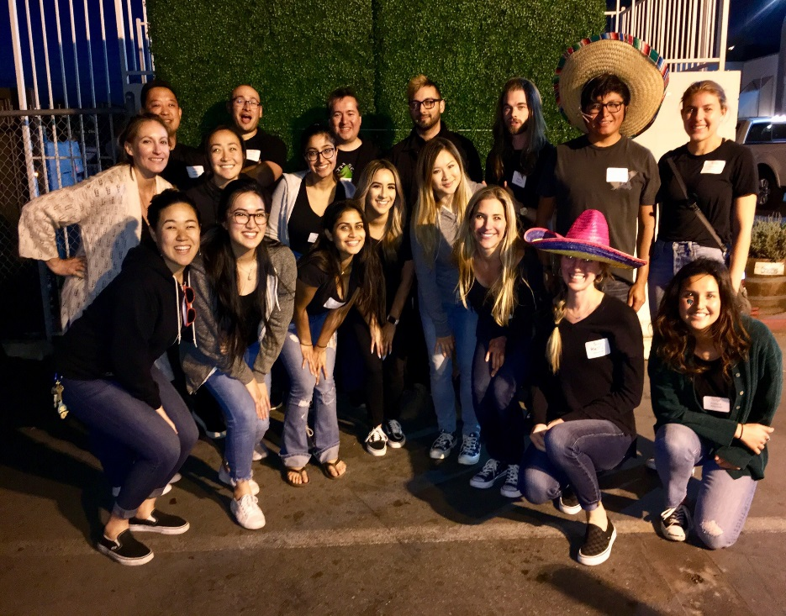
Fall 2017
BLS Training Certification
Spring 2018
Pre-Med Club Bake Sale Fundraiser
Coastline College Health Fair NBC
Share Ourselves Taco Night Fundraiser
Relay for Life of La Mirada Cancer Walk
PRE-MED CLUB
Tomorrow’s College Today.

Slide 73
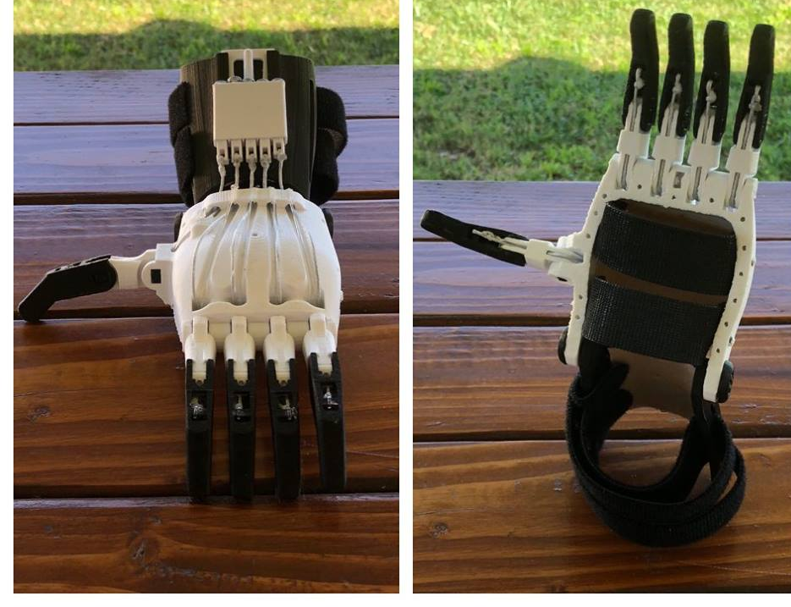
WORK STUDY
IN BIOLOGY
PROSTHETICS FOR
CHILDREN
Tomorrow’s College Today.

Slide 74
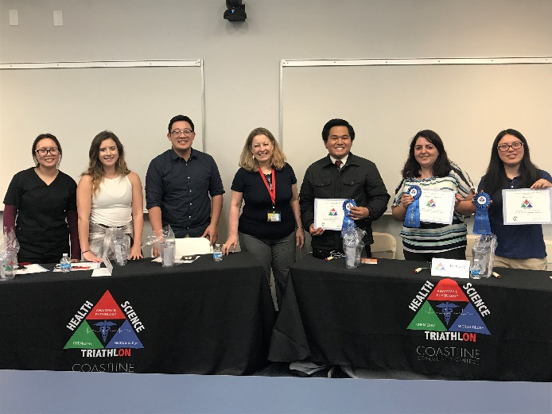
3rd HEALTH SCIENCE
ACADEMIC TRIATHLON
Tomorrow’s College Today.

Slide 75
BIOLOGY SPRING 2019
100C
221
OER
BIO 220 (3 of 8)
122
104
106
200
282
291-293
18
LABs at .85
Class size onsite 30-40
Online 45-84
Telecourse 270
BIO 100, 100 L, 100C (20)
BIO106/ECOl106
LAB MANUAL
BIO 180
BIO 225
BIO 210 (revision in progress)
NEW CLASSES
PART TIME
OER
Tomorrow’s College Today.

Slide 76
FROM THE ENROLLMENT MANAGEMENT PLAN April, 2018
Planning Assumptions
increase site-based enrollments and continue to improve space utilization (cap:load ratios)
increase the number of full-time students
Academic Year 2012-2013 2013-2014 2014-2015 2015-2016 2016-2017 2019-2020 Biology 443 454 446 526 501 530
We are the second highest generator of FTES at Coastline
Tomorrow’s College Today.

Slide 77
Program Review Initiatives-New
Start a Nursing Program
Develop Pharmacy Technician Pathway
Develop Physical Therapy Aid Pathway
Diving Certification Program Marine Science
Study Abroad: Diversity of Organism, Ecology
Create a Learning Library
Fund Lab Manuals
Create a Marketing Plan
Tomorrow’s College Today.

Slide 78
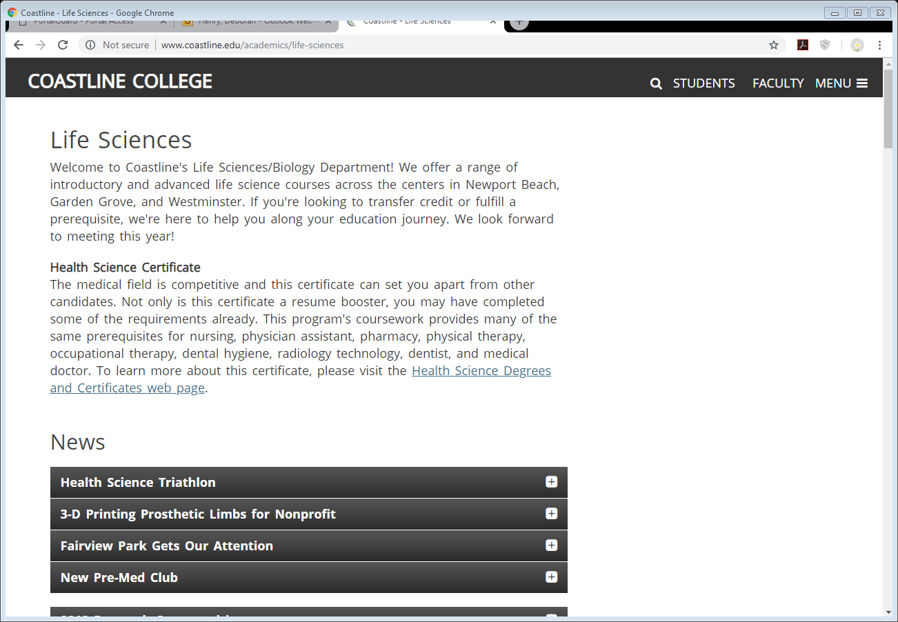
Program Review Initiatives-New
Tomorrow’s College Today.

Slide 79
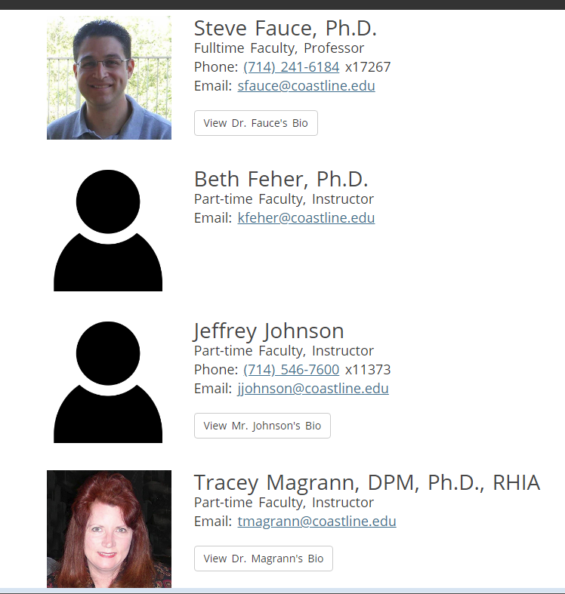
THANK YOU BIOLOGY FACULTY

Slide 80
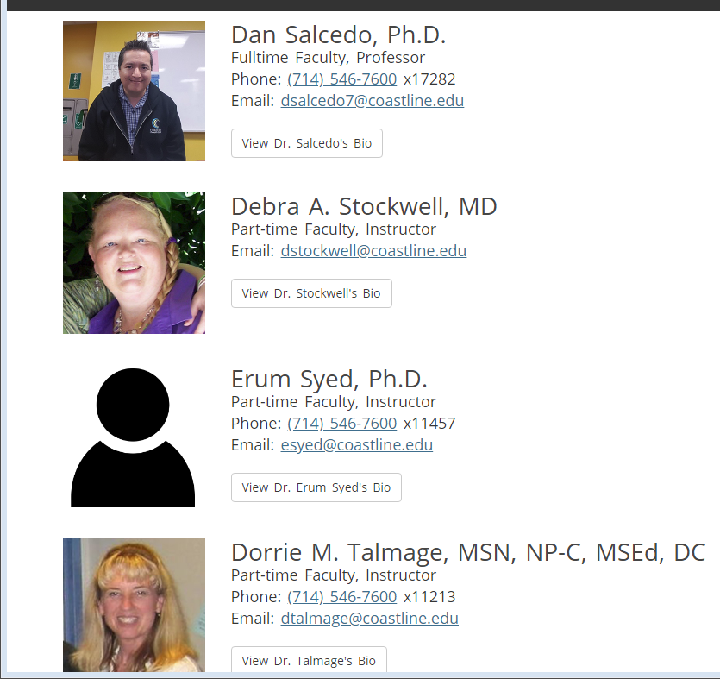
Tomorrow’s College Today.

Slide 81
Tomorrow’s College Today.

Slide 82
FULL TIME POSITION
4
THE ARTS
Multi Disciplinary Professor
Fine and Performing Arts

Slide 83
Support NOW in:
3D Design
2D Design
Foundations
Ceramics
History of Art
Support the future in:
Online History Degree/Certificate
Reaching out to other departments
History
English
Library

Slide 84
Contemporary approach to making careers in the Arts
Goal
Entry level design studio positions.
Jack/Jane of all creative trades
Educating
INDISPENSABLE INDIVIDUALS

Slide 85
The basics hand building skills
Foundation drawing
2d
3d
Mixed media
Production
CREATIVE PROBLEM SOLVING

Slide 86
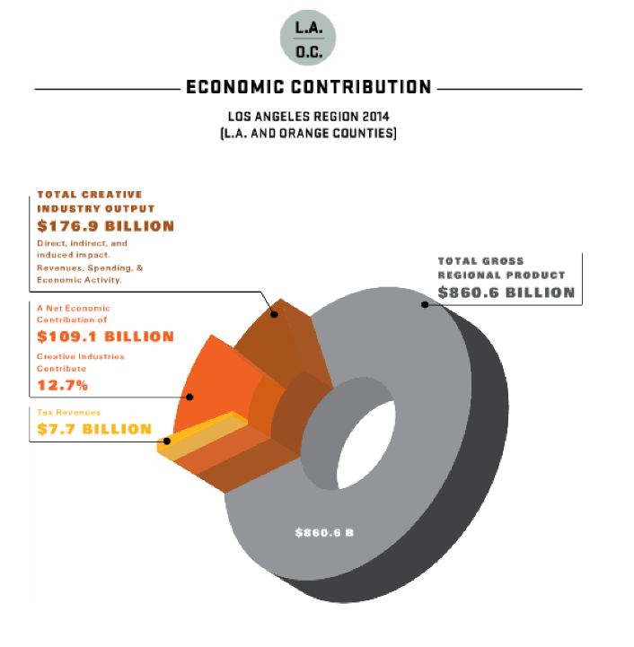

Slide 87
LA/OC • GROSS REGIONAL PRODUCT
$860.6 BILLION
CREATIVE INDUSTRY OUTPUT
$176.9 BILLION
NET ECONOMIC CONTRIBUTION
$109.1 BILLION
12.7% IN THE REGION
$7.7 BILLION IN TAX REVENUE

Slide 88
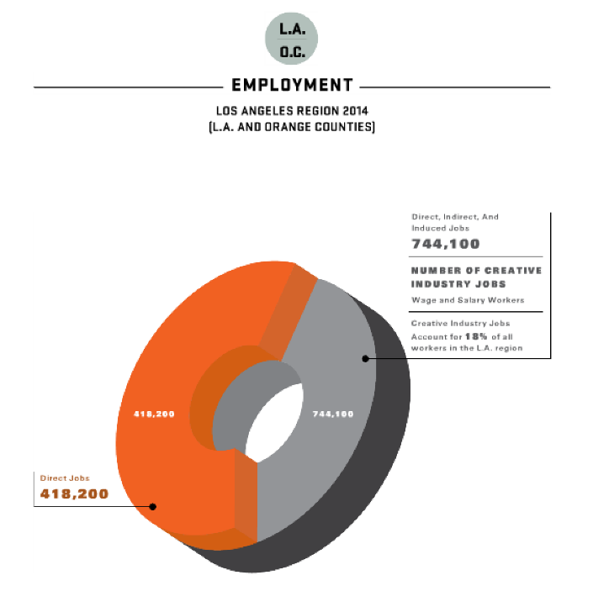

Slide 89
ALMOST 800,000 JOBS IN LA/OC EXIST
BECAUSE OF CREATIVE INDUSTRY
18% OF THE JOBS IN LA/OC
MORE THAN 400,000 ARE DIRECTLY RELATED TO THE CREATIVE ARTS

Slide 90
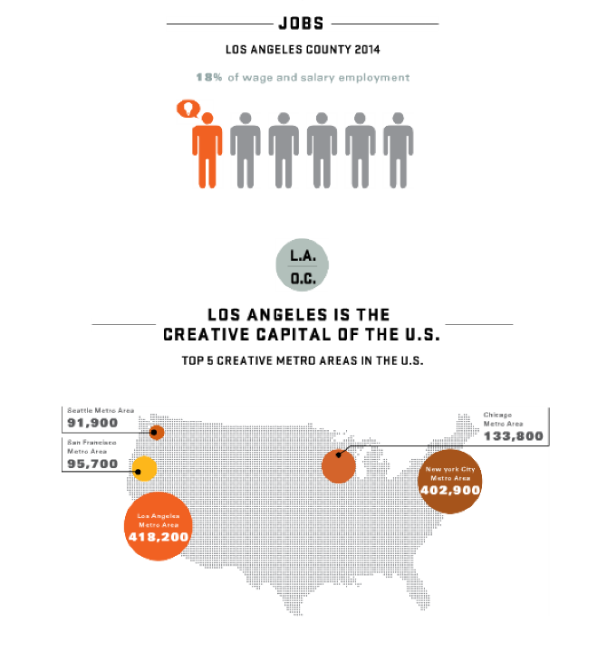

Slide 91
ONE OUT OF SIX JOBS IN LA/OC
LA/OC IS NUMBER ONE
WE ARE THE
CREATIVE CAPITOL OF
USA

Slide 92
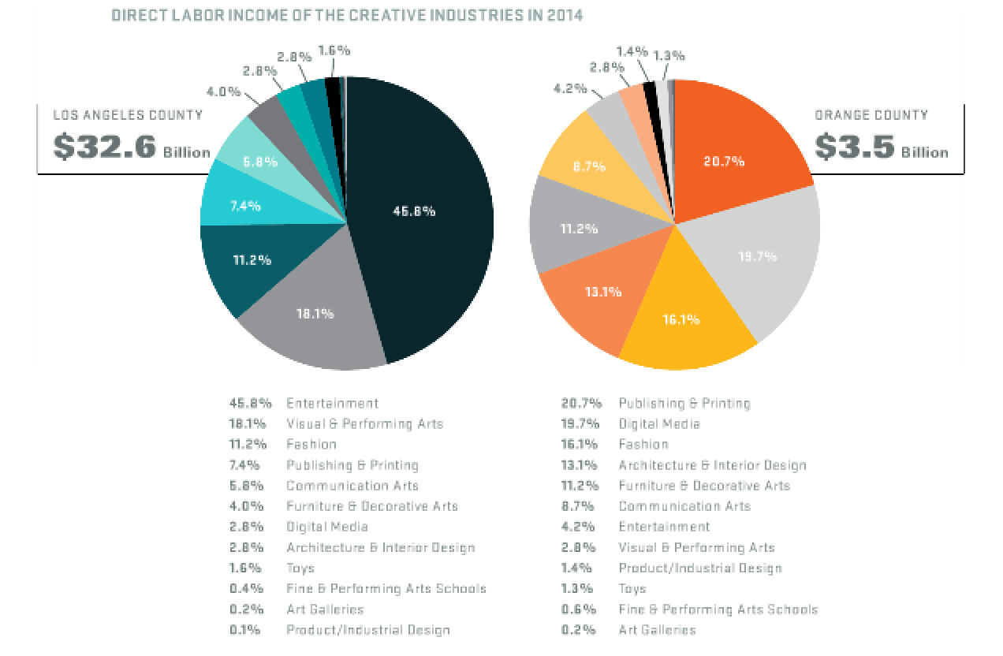

Slide 93
It all starts here

Slide 94
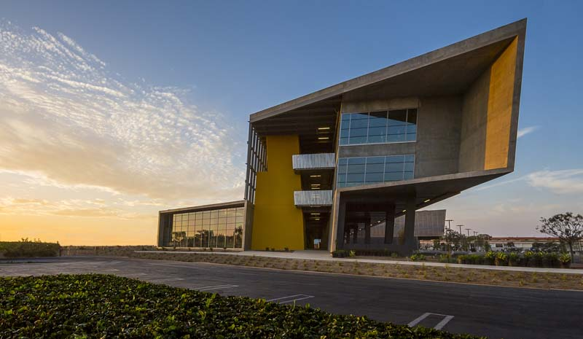

Slide 95
To get
a job Here

Slide 97
YOUR NEW COLLEAGUE
SHOULD BE
COMMUNICATION STUDIES FACULTY

Slide 98
“ employers rank skills such as critical thinking and communication –hallmarks of the liberal arts – above technical aptitude as essential for career readiness”
Study conducted by -The National Association of Colleges and Employers

Slide 99
PROGRAMATIC PLANNING
New Modality For Offering Classes
Allows Students To Complete Degree Completely Online.
Will increase course and section offerings.
Multiple credit and non-credit certificates for employable skills will be developed
Communication Skills ARE the NUMBER 1 Skills that employers desire before offering employment.
Development of OER Materials

Slide 100
PROGRAMATIC PLANNING
COLLEGE AND FACULTY LEADERSHIP
Participation in college committees and work groups
Participation in Coastline Pathways Initiatives
Student Organization Involvement
Disciplinary and Interdisciplinary Collaboration
Student, Staff, and Faculty Training

Slide 101
Climate, Job Market, Trends & Mandates
Improve Transfer Rates
Two of the CSU Golden Four are CMST courses.
Program Growth will
Meet needs of 100% Online Students
Increased attainment of
associates degrees,
certificates
Transfer to four-year colleges and universities

Slide 102
Climate, Job Market, Trends & Mandates
Employability
Oral communication skills required by all employers
Research Skills wanted by employers
Critical Thinking Skills wanted by employers
Organization skills wanted by employers

Slide 103
MATH – Faculty Prioritization 2018

Slide 104
MATH – Faculty Prioritization 2018
Math classes continue to increase every year!
More part-time instructors are hired every year (more new PT instructors just hired for Spring 2019)!

Slide 105
MATH – Faculty Prioritization
All FT faculty teach overload.
All FT faculty are over-burdened trying to attend professional development workshops, implement new curriculum and implement AB 705
AB 705 is changing everything ! ! ! !

Slide 106
MATH – Faculty Prioritization 2018
College-level courses filling with under-prepared students
Concurrent and co-requisite support courses need to be developed, scheduled and staffed.

Slide 107
MATH – Faculty Prioritization 2018
FT and PT faculty need to be trained and mentored in this new method of teaching under-prepared students.
Technology, study skills, metacognition, self-efficacy, persistence, collaboration, communicating mathematically, proper use of discussion, onsite and online—all very challenging to teach!

Slide 108
MATH – Faculty Prioritization 2018
Just-in-time remedial instruction and dealing with affective needs are best accomplished in smaller class sizes (25-30 versus 60 or 80 students)!
More instructors will be needed to teach more sections

Slide 109
MATH – Faculty Prioritization 2018
Growing enrollment in science, business, English, cyber-security, economics, psychology, etc. which all require math, means
These students will need to be successful in their math classes!

Slide 110
MATH – Faculty Prioritization 2018
More on-site classes will be needed in the near future which will need to be taught by full-time instructors!
Hard to hire PT to teach on-site

Slide 111
MATH – Faculty Prioritization 2018
Statistics enrollment is growing faster than ever before!
Other upper division especially Calculus 1/2/3 math STEM classes are growing faster than ever before (word about Coastline is spreading)!
We need more full-time faculty to teach and develop this curriculum!

Slide 112
MATH – Faculty Prioritization 2018
The number of math sections will continue to grow; needed to satisfy regional and national demand, sustain other programs, other majors, the job market climate, and to align with the College Mission and our Program Review!

Slide 113
MATH – Faculty Prioritization 2018
Thank You!
For more info visit https://coastlinemath.com

Slide 114
Physical Sciences FT Faculty BegFest Fall 2018
Astronomy, Chemistry, Geology and Physics
FT Faculty: Jean Dupon and Ted Marcus (Chemistry)
David Devine (Astronomy and Physics)

Slide 115
Physical Sciences: Faculty (3 FT; 16 PT)
Astronomy
½ FT: David Devine (Physics and Astronomy)
1 PT: Mahbub Khan
Chemistry
2 FT: Jean Dupon (recently tenured), Ted Marcus
8 PT: Frederick Anvia, Rayya Bourche, Helen Gundy, Ken Ostrowski, Mohammad Shahin, Vinh Tran, Mandana Villa-Visi, Eddie Wen

Slide 116
Physical Sciences: Faculty (3 FT; 16 PT)
Geology
0 FT (Debbie Secord retired SP 17)
5 PT: Roberto Falero, John McNamara, Kelly Ruppert, Kathy Schubel, Curtis Williams
Physics
½ FT: David Devine (Physics and Astronomy)
3 PT: Derek Bryant, Diego Gutierrez, Mahbub Khan

Slide 117
Physical Sciences: Teaching
ASTRONOMY
Faculty | ½ FT (Devine) | 1 PT
FA 18 Courses | 1 Lecture 1 Lab | 5 sections
Students (Census) | FA18: 402 | FA17: 344
CHEMISTRY
Faculty | 2 FT (Dupon, Marcus) | 8 PT
FA 18 Courses | 5 ½ Lecture 4 ½ Lab | 21 sections
Students (Census) | FA18: 442 | FA17: 463

Slide 118
Physical Sciences: Teaching
GEOLOGY
Faculty | 0 FT | 5 PT
FA 18 Courses | 3 Lecture 2 Lab | 12 sections
Students (Census) | FA18: 530 | FA17: 359
PHYSICS
Faculty | ½ FT (Devine) | 3 PT
FA 18 Courses | 3 ½ Lecture 2 ½ Lab | 5 sections
Students (Census) | FA18: 154 | FA17: 107

Slide 119
Begging For: FT Geology
Why FT GEOLOGY?
Replacement for Debbie Secord (retired SP 17).
Sufficient demand in Geology to support a FT hire.
No Geology FT Faculty = No Geology curriculum oversight, potential stagnation and decay.
U.S. Department of Labor predicts a shortage of Geoscientists by 2026.
Expected job growth of 14% for 2016-2026 (faster than the average for all occupations)
Develop much needed new courses (GEOL 106 for Elementary Teachers, Field Trips to take advantage of Southern California’s unique geology).
Geosciences are an important part of STEM.
National emphasis on STEM fields and STEM grants.

Slide 120
Begging For: FT Physics
Why FT Physics?
Devine needs help in order to continue to grow Physics and Astronomy
Sufficient growth in Physics and Astronomy to support a FT hire in Physics.
Expected job growth for Physics and Astronomy is 14% for 2016-2026 (faster than the average for all occupations)
Ideal hire should straddle Applied Physics/Engineering
Put the STE in STEAM
Physics is an essential component of STEM.
National emphasis on STEM fields and STEM grants.

Slide 121
EOPS, CARE & Next Up
Faculty Prioritization Presentation October 16, 2018

Slide 122
Historical Context: Once upon a time…
In fall of 2016 EOPS was given information from the state Chancellor’s office about additional funding being available
Growth was encouraged, and the State Chancellor’s office said there would be compensation for growth in the funding formula for EOPS
EOPS more than doubled in size through targeted outreach and the addition of an EOPS program application that was made available online

Slide 123
Trends and Predictions
EOPS | 2014-15 | 2015-16 | 2016-17 | 2017-18
Headcount | 176 | 215 (+39) | 403 (+188) | 383 (goal = 422)
Success | 79.1% | 77.7% | 75.3% | 80.1%
Retention | 90.3% | 89.1% | 88.9% | 91.1%

Slide 124
Number of EOPS Counseling Hours Provided by Adjunct Counselors
2016 - 2017 1,967 hours of Counseling appointments were provided by adjunct counselors.
Hours projected for 2018 – 2019 1408, which is a substantially less due to a decrease in funding in the Next Up Grant.

Slide 125
What Counselor Currently Do…
Academic Counseling / Intake
Career Counseling / Assessments
Transfer Counseling / Evaluations
Financial Aid Counseling/Assistance
Personal/Social Counseling & Referrals
Meet with students 3-4 times per semester (Title 5 mandate)
Advisory Committees / Outreach
Participation in Cultural Enrichment Activities
Develop in-person workshops
Develop online workshops
Guided Pathways Steering Committee
Community Partnerships (establish & maintain)
Referrals (child care, food, health, life-skills)

Slide 126
What We Would Like To Do
Increase opportunities for Distance Learners and incarcerated students by increasing our numbers
Develop Workshops using Cranium Cafe
Develop Workshops using Canvas
Develop a Department Shell in Canvas
Increase access to EOPS services
Expand our Coastline EOPS Community Virtually
Establish regularly scheduled Counseling 105 course sections under EOPS
Provide faculty with opportunities to invite EOPS Counselors to present information about EOPS (in-person & virtual)
Establish better support services for Hispanic/Latina/o and African American student populations (HSI & Umoja)
Participate in Hispanic Association of Colleges and Universities (HACU) Conferences

Slide 127
Why Should EOPS Be $upported?
Equity is at the forefront of our Guided Pathways model, and EOPS is an Equity program, which was Civil Rights enacted in 1969
We do what we do well, with a success rate of 80%
Our approach is holistic and we meet students where they are at
We are already addressing all four components of the Guided Pathways framework:
Clarifying the path Entering the path
Staying on the path Ensuring students are learning

Slide 128
What College Goals Would Having Another Full-Time Tenure Track Counselor Support
Student Success, Completion, and Achievement
Instructional and Programmatic Excellence
Access and Student Support
Student Retention and Persistence
Culture of Evidence, Planning, Innovation, and Change
Partnerships and Community Engagement

Slide 129
What Educational Master Plan Objectives Would Having a Second F/T Counselor in EOPS Support?
Increase student success, retention, and persistence across all instructional delivery modalities with emphasis in distance education.
Strengthen post-Coastline outcomes (e.g., transfer, job placement).
Foster and sustain industry connections and expand external funding sources (e.g., grants, contracts, and business development opportunities) to facilitate programmatic advancement.
Strengthen community engagement (e.g., student life, alumni relations, industry and academic alliances).
Maintain the College’s Asian American and Native American Pacific Islander Serving Institution (AANAPISI) designation and support becoming a designated Hispanic Serving Institution (HSI).

Slide 130
Evidence Supporting Our Need
Program Review Supports innovative approaches to continue serving our current numbers:
Title 5 mandates 3 appointments for EOPS/CARE and 4 for Next Up
Reduction in appointment time from 60 min to 45 min
Collaboration across campus offices and community partners
Development of “Group Counseling” appointments (Title 5 allows for one of these per semester)

Slide 132
Coastline Counseling Department
Faculty Hiring Prioritization Presentation
Academic Senate
October 16, 2018

Slide 133
Counseling Department Request 2019 - 2020
Two Full-Time Counselors

Slide 134
Counseling Department Expectations
Preparation for Guided Pathways
Transition to Case Management Counseling Model
Incarcerated Student Population

